Slide 1
CalvertHealth Mini Tutorial ED Universal Discharge
Must be viewed in Slide Show
(Slides are layered)

Slide 2
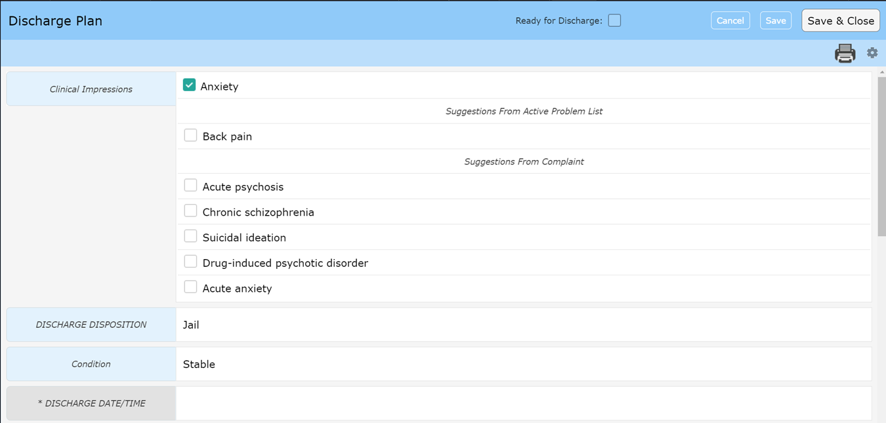
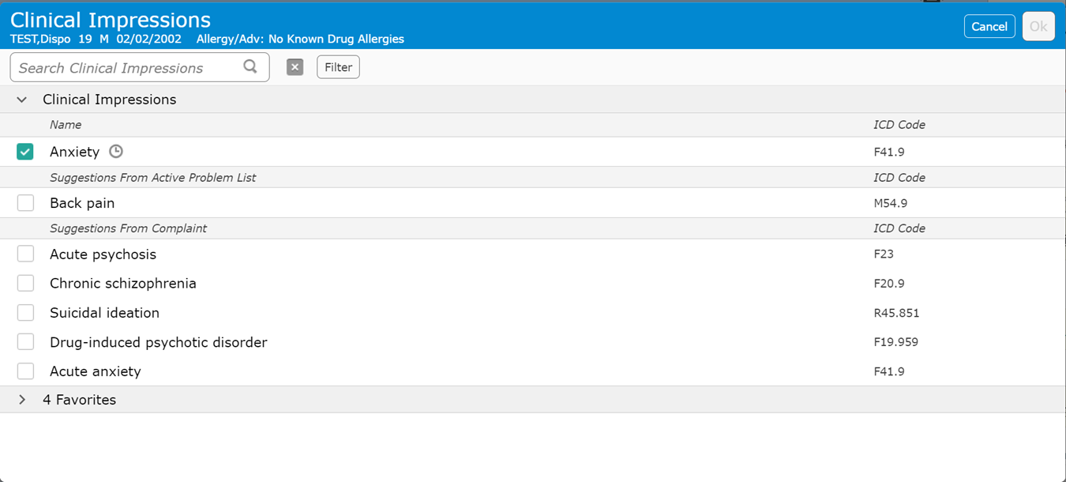
Universal Discharge ED
Ready for Discharge – Flags the nurse
Specificity may need to be added to generate an ICD-10 Code
Clinical Impression
Click on Blue area to search for alternatives

Slide 3
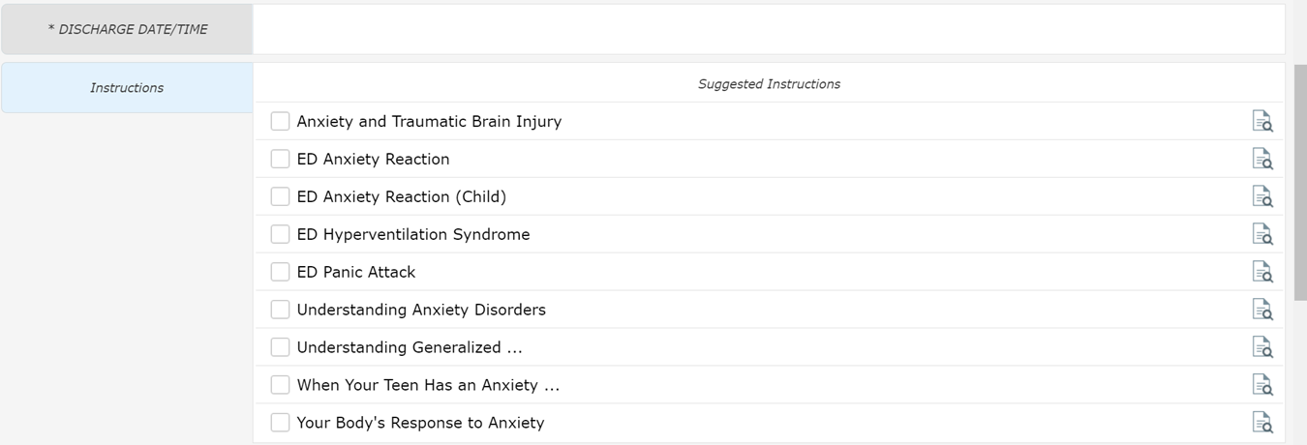
Universal Discharge ED
Discharge Date/Time
Nursing function – This field actually discharges the patient
Instructions
Suggestions if recommended Clinical Impression selected
Clicking anywhere in this area will allow you to search for additional instructions

Slide 4
Universal Discharge ED
This section has the same functionality as discussed “Prescriptions” Mini Tutorial
The order may be different

Slide 5
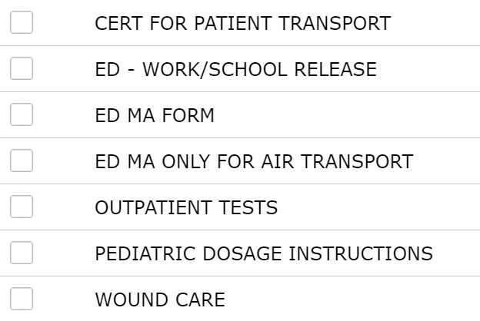
Universal Discharge ED
The ED – Work/School Release form is visible but others are available
Transfer to – Hospital list
May have to search by name due to list size
This is a shared field which causes issues when multiple providers are signing Doc
Reason for Transfer – justification for transfer
Accepting provider – Receiving facility

